Slide 1

Reducing Electricity Costs in Romania: Predictive and Reinforcement Learning for Solar Battery Optimization
Authawich N.
Image Source: https://auroraer.com/insight/exploring-the-new-wave-of-subsidy-support-in-romania-and-hungary/

Slide 2

Introduction
Romania relies heavily on diverse energy sources like nuclear, wind, hydroelectric, oil and gas, solar, and biomass.
The three primary sources of electricity in Romania are hydro electric, producing 2,035 MW/h, oil and gas, generating 1,605 MW/h, and nuclear, contributing 1,378 MW/h.
Solar power is not a main source of electricity, producing around 150 Megawatts per hour and is only available during daylight hours, typically between 7AM and 6PM.

Slide 3
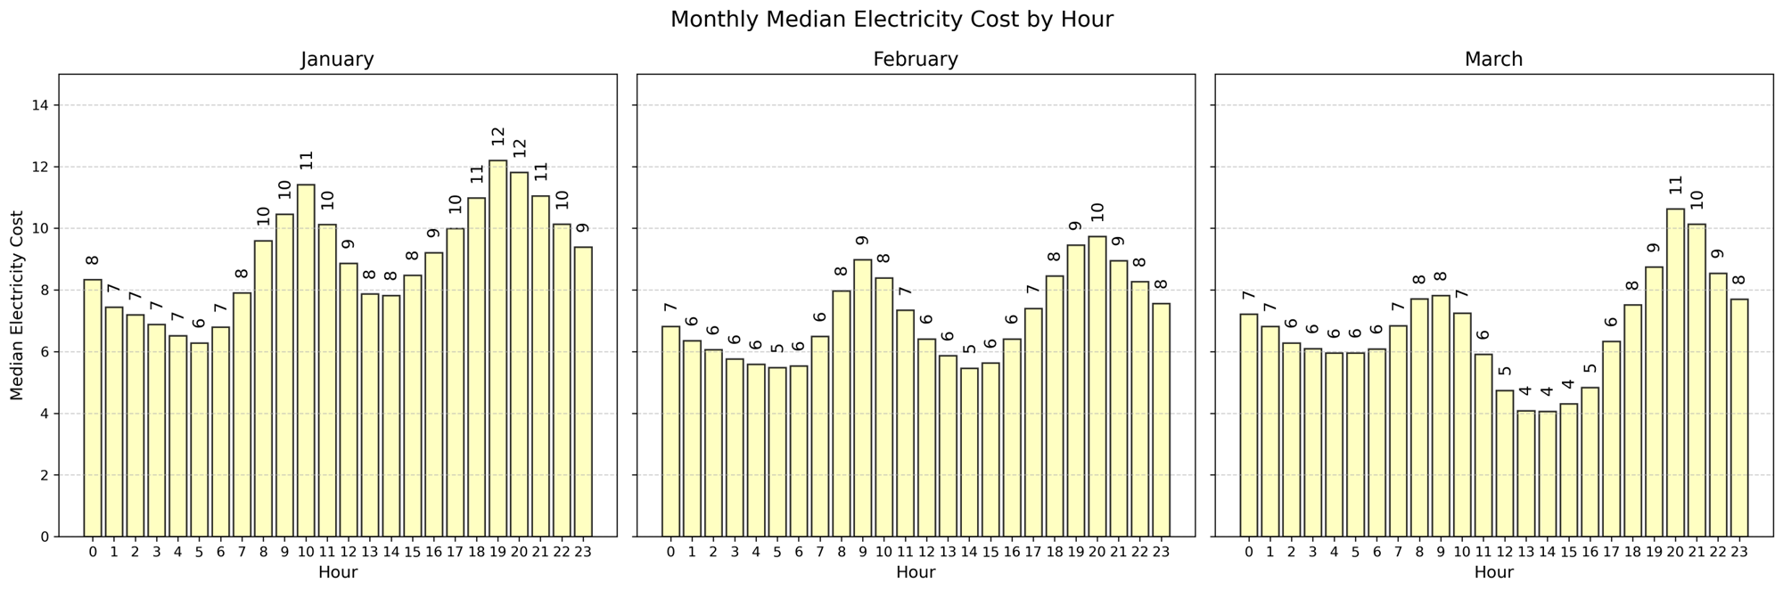
Introduction – Electricity Cost
The hourly electricity cost fluctuates between peak (9-11 AM, 5-7 PM) and off-peak hours, forming a multimodal distribution with two distinct peaks.

Slide 4
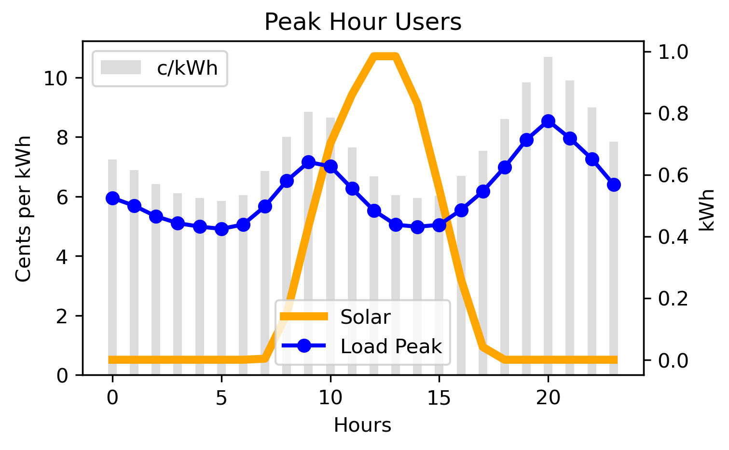
Problem Statement
Problem Statement
Households with solar panels face the challenge of reducing electricity costs by effectively analyzing hourly solar generation and electricity prices to determine the optimal timing for battery charging and discharging.
Why it is hard?
Solar energy production varies throughout the day due to uneven sunlight intensity.
Electricity costs fluctuate between peak and off-peak hours.
Charge
Discharge
Battery +0.15 kWh
Battery -0.5 kWh
Electricity Cost 8 × 0.6 = 4.8 Cents
Electricity Cost = 0 Cents

Slide 5

Agenda
Exploratory Data Analysis
Insight from Predictive Models
Introduction to Reinforcement Learning
Solar Battery Optimization
Final Results

Slide 6
Data sources
The data was extracted from 3 sources
Weather in Bucharest, Romania: Visual Crossing's weather data services
Electricity Cost per Hour: Thingler, by interpreting the bar charts and making personal notes
Electricity Production per Hour: Kaggle
All three datasets cover the period from January 2024 to March 2024 on hourly basis, (2160 rows).
The data for March 31, 2024 was intentionally removed due to missing one hour because of daylight saving adjustments.

Slide 7
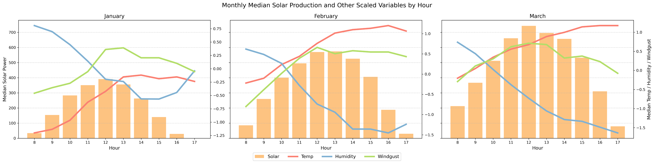
Exploratory Data Analysis
Relationship between Weather and Solar Energy
Temperature and Wind show positive relationship with solar power.
Humidity shows a negative relationship.

Slide 8
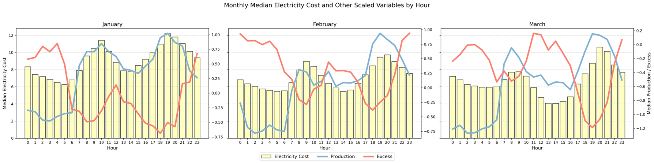
Exploratory Data Analysis
Relationship between Electricity Production and Electricity Cost per Hour
Electricity costs are positively related to energy production.
However, when there is excess production, electricity costs decrease, showing a negative relationship.

Slide 9
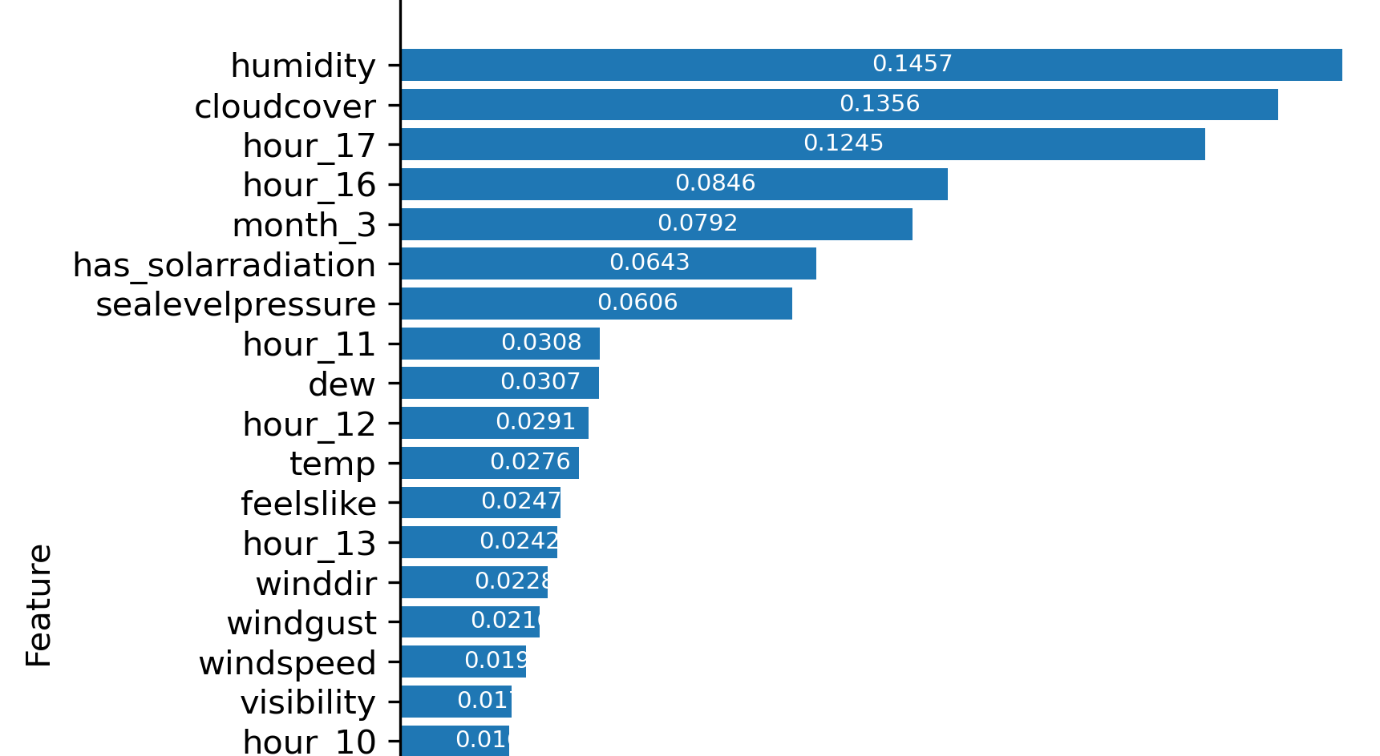
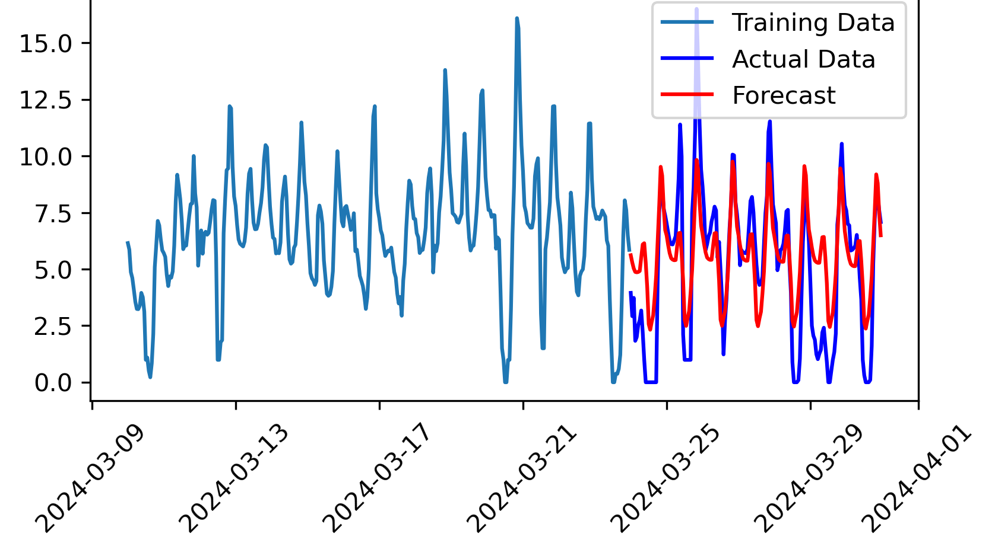
Insight from Predictive Models
Solar Energy Prediction Models
The gradient boosting model achieved R² of 0.90
Top three weather-related features are humidity, cloud cover, solar radiation availability.
Note: Train 80% Test 20%
Electricity Cost Prediction Models
The data is stationary and exhibits a 24-hour seasonality. The time series analysis was conducted using SARIMAX, achieved a root mean squared error of 2.22 cents per kilowatt as the difference between the actual and forecasted values over the last 168 hours of data.
Solar Energy Prediction Models: Feature Importance from Gradient Boosting Model
Electricity Cost Prediction Models: The SARIMAX with 24-hour seasonality

Slide 10


Introduction to Reinforcement Learning
Training Loops
n^{th} Episode
After learning for a while, the agent will follow Q-Table
Agent
Reinforcement Learning (RL) is a branch of machine learning where an agent learns to make decisions by interacting with an environment to maximize cumulative rewards.
The agent observes the state of environment, takes actions, and receives feedback in the form of rewards. Overtime, the agent learns a policy, a mapping from states to actions, that maximizes the expected cumulative rewards.
One of the foundational methods in reinforcement learning is Q-learning.
Random
or Choose
Action A_{t}
Q-Table
Environment
State S_{t}
 | A₀ | A₁
S₀ | -1.1 | 2
S₁ | 0 | -0.5
Reward R_{t}
Update
t = t + 1
or Terminate

Slide 11
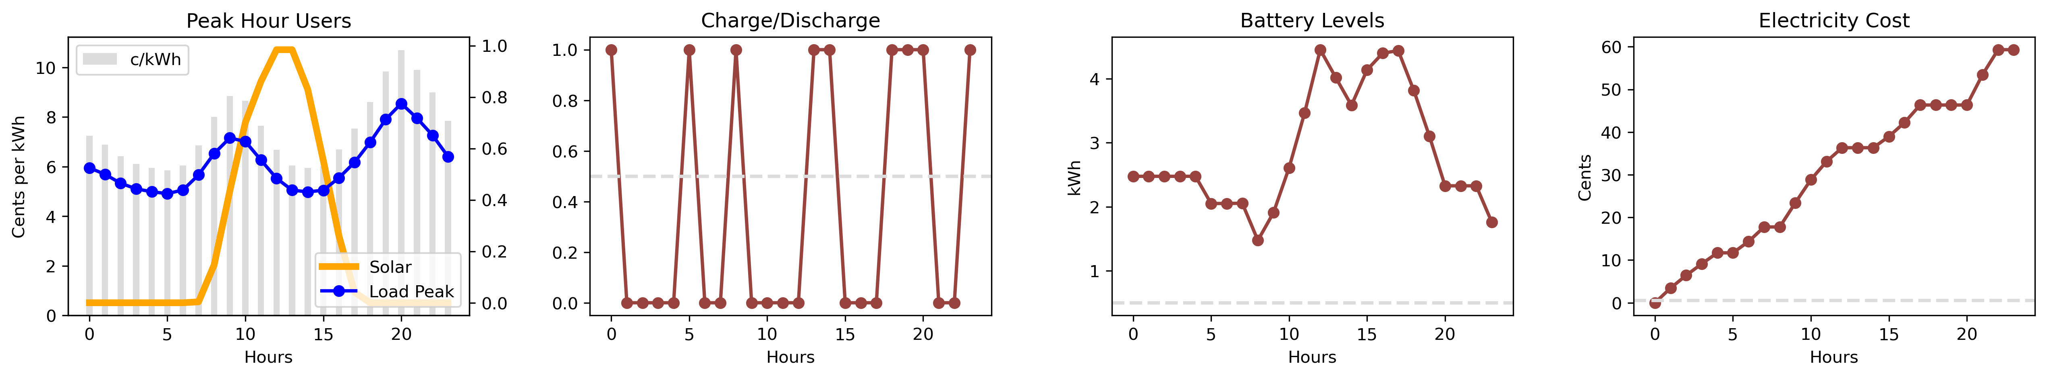
Solar Battery Optimization
Environment
Varies at each Hour
Solar Energy (total 5.8 kWh)
Electricity Cost (c/kWh)
Load Profile (total 13 kWh)
State
Hour (0 – 23)
Battery Levels (initial = 3 kWh)
Actions
If Charge:
Battery Level Increases
If Discharge:
Battery Level Decreases
Rewards
- Electricity Cost
If Charge:
Electricity Cost × Load Profile
If Discharge:
Electricity Cost × Excess Load Profile
First Episode Results: Battery Remaining 1.76 kWh, Total Electricity Cost 59.31 Cents

Slide 12
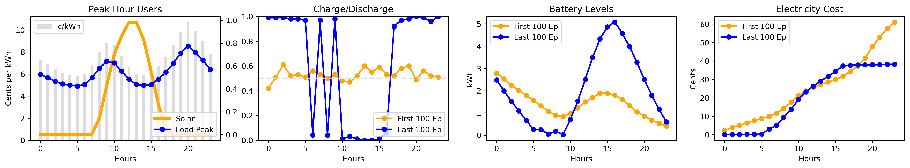
Final Results
Overall
The learning converges after 4,709 Episodes. In the first 100 episodes, the agent randomly chooses actions. However, by the end, it confidently makes decisions.
Strategy
The agent discharges batteries in the morning, charges them at midday when the electricity cost per hour declines and solar energy reaches its peak, and uses the stored energy for the rest of the day.
Results
The electricity cost in the first 100 episodes is 61.14 cents, while in the last 100 episodes it is 38.25 cents, reflecting a reduction of 37%.

Slide 13

Key Takeaways
Solar energy production varies hourly due to weather factors such as humidity, cloud cover, and solar radiation.
Electricity costs fluctuate based on excess production, exhibiting a 24-hour seasonality.
Using Q-learning, a model was developed that reduces electricity costs by approximately 37%.
These findings demonstrate how reinforcement learning can optimize household solar energy use and reduce electricity costs.

Slide 14
Thank you for listening
Authawich N.
Image Source: https://auroraer.com/insight/exploring-the-new-wave-of-subsidy-support-in-romania-and-hungary/

Slide 15
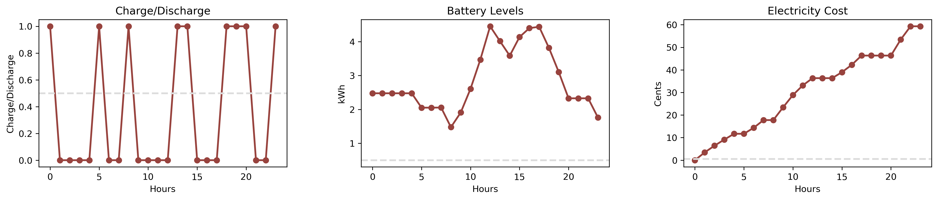
First Episode Peak Hour Users
Results
Agents choose charging at Hour 1, 2, 3, 4, 6, 7, 9, 10, 11, 12, 15, 16, 17, 21, 22
Battery Remaining 1.76 kWh
Total Electricity Cost 59.31 Cents

Slide 16
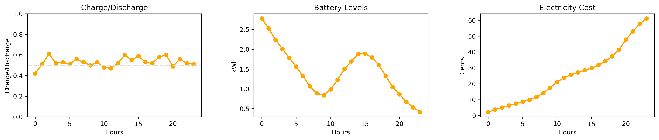
First 100 Episodes Peak Hour Users
Average Results
Agents randomly choose actions
Battery Remaining 0.41 kWh
Total Electricity Cost 61.34 Cents

Slide 17
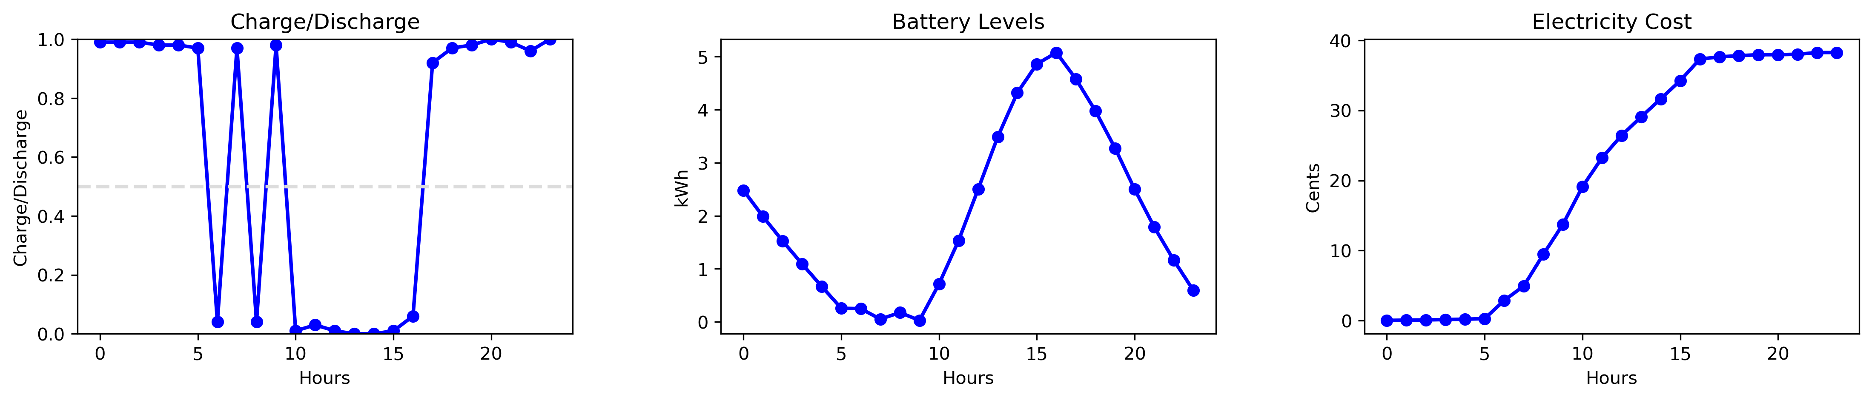
Last 100 Episodes Peak Hour Users
Average Results
Agents randomly choose actions
Battery Remaining 0.41 kWh
Total Electricity Cost 38.25 Cents

